Slide 1
Lariat Financial Analysis and Recommendations
By Mindi Suttor

Slide 2
Agenda
Company goals
Current financial status
3 options for potential profit increases
Option comparison
Recommendations

Slide 3
Company Goals
Increase annual profit by 10%
Lariat profit in the past 12 months: $22.5 million
12-month goal: $24.75 million

Slide 4
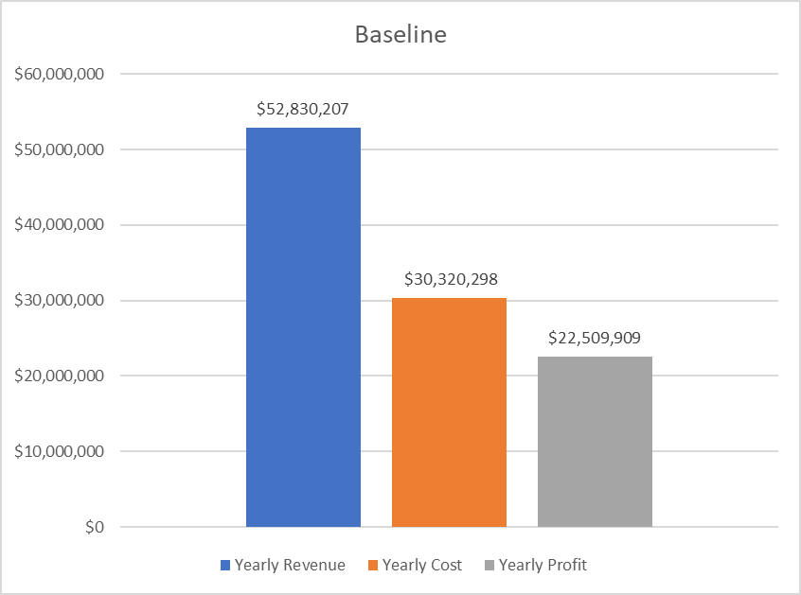
Current Lariat Financial Status
* Lariat financial statistics for the past 12 months.

Slide 5
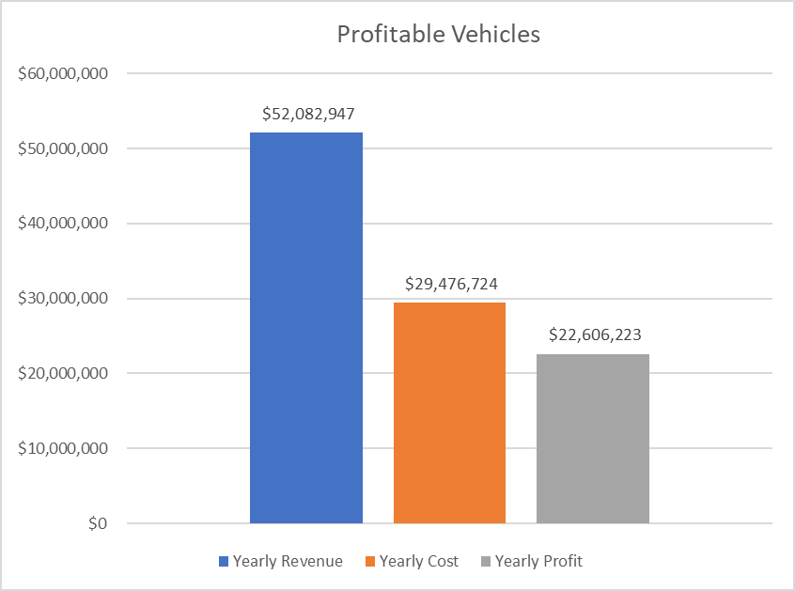
Remove Unprofitable Vehicles
This model removes all vehicles that had a negative profit margin from the fleet.
Despite reducing the number of vehicles in the fleet, Lariat’s profits increased by $96,300 from baseline.
Notes:
Vehicles with negative profit margins were removed, eliminating 99 vehicles from Lariat's fleet. Despite having minus 99 vehicles, Lariat's profit increased from by $96,314 from the baseline. Therefore, profit can be increased simply by eliminating vehicles that are operating at a loss.
- There are minimal additional costs associated with this option besides those required to sell off the unprofitable vehicles.

Slide 6
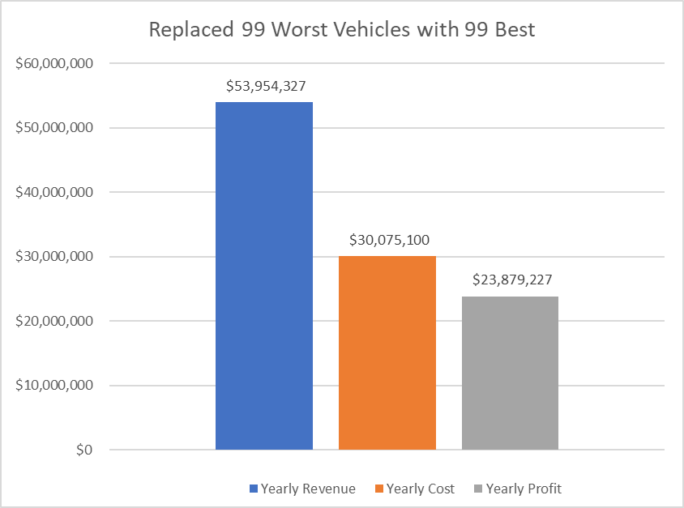
Vehicles Substitution
All 99 vehicles with negative profit margins are removed.
These vehicles are replaced with the 99 most profitable vehicles in the fleet.
This produces a $1.37 million increase in profit from the baseline.
Notes:
In addition to removing the vehicles operating at a loss, the 99 best vehicles were duplicated and added to the fleet, producing a $1,369,318 increase in profit from the baseline. * This model assumes the vehicles that were added have the same costs associated as their duplicates.
* Does not include costs associated with buying new vehicles. This should be partially offset by selling the vehicles with negative profit margins.

Slide 7
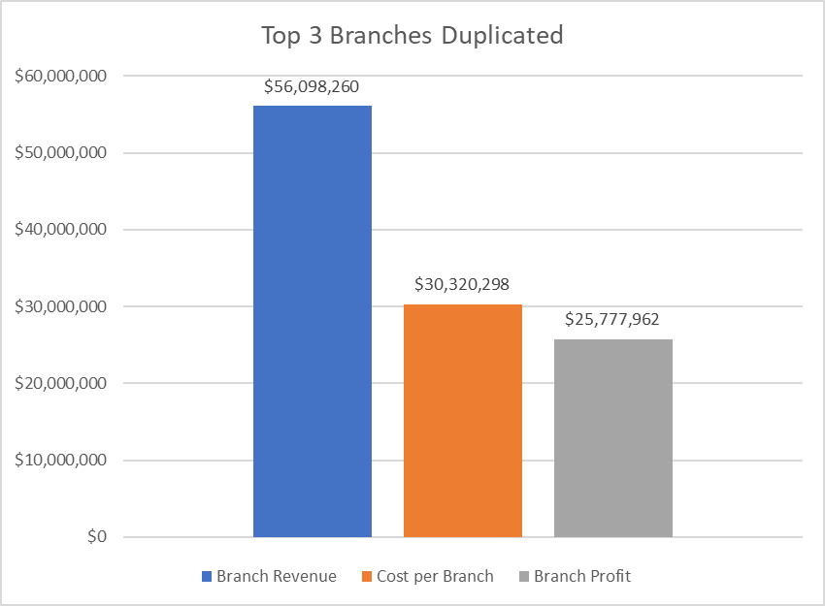
Branch Duplication
The 3 branches with the most profit were duplicated.
Results in a $3.2 million increase in profit from baseline
Does not include the costs associated with installing new branches in these locations.
Notes:
The three most profitable branches were duplicated, resulting in a $3,268,053 increase in profit from baseline. This shows that by adding an additional location to the most profitable cities, Lariat could significantly increase profits. *This assumes the branch profit and expenses remain consistent in the newly added locations.
*Does not include the costs that are associated with installing new branches in these locations. Breakeven point must be calculated. Since the increase in profit from this model is $3.2 million, you would take whatever the costs are for installing the branches and divide by the estimated profit.

Slide 8
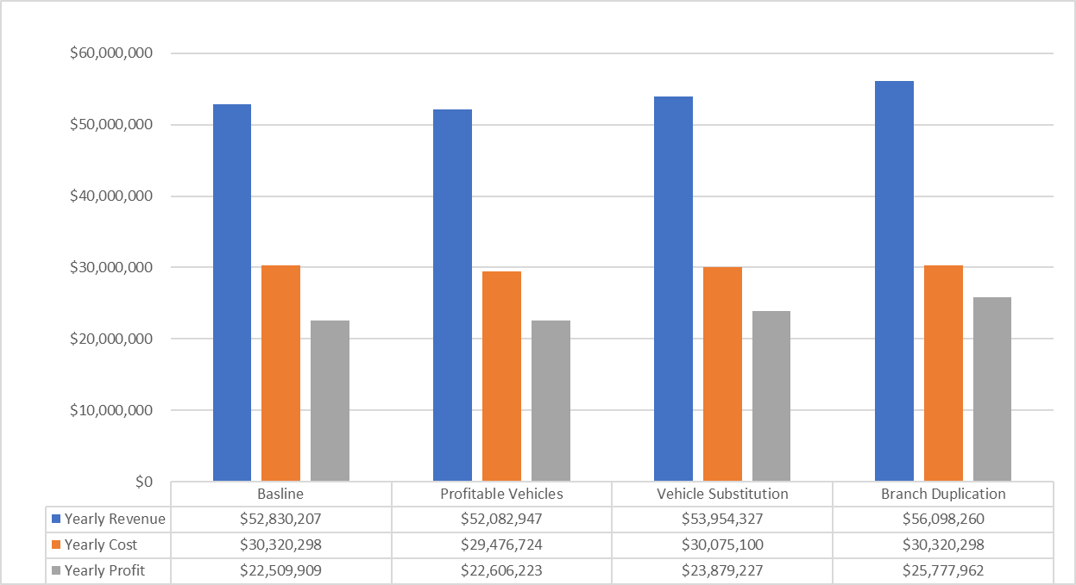
Model Comparison
Notes:
Profitable vehicles is a $96,300 increase from baseline
Vehicle substitution is a $1.37 million increase from baseline
Branch duplication is a $3.2 million increase from baseline
Combined profit increase from implementing the vehicle substitution and branch duplication option is $4.57 million, resulting in a total profit of $27.1 million
This is a 20.3% increase from the baseline profit, significantly exceeding the goal of 10%

Slide 9
Recommendations
Implement vehicle substitution and branch duplication strategies.
Vehicle substitution increases baseline profit by $1.37 million.
Branch Duplication increases baseline profit by $3.27 million.
Total Lariat profit increase of $4.64 million.
This results in a 20.3% increase in the baseline profit which significantly exceeds the goal of 10%.
Notes:
* These models assume that expenses and profit for the vehicle substitution and branch duplication models remain consistent when duplicated.
* Branch duplication does not take into account the cost of opening a new location. This would need to be calculated to determine the break even timeline.
Profitable vehicles is a $96,300 increase from baseline
Vehicle substitution is a $1.37 million increase from baseline
Branch duplication is a $3.2 million increase from baseline
Combined profit increase from implementing the vehicle substitution and branch duplication option is $4.57 million, resulting in a total profit of $27.1 million
This is a 20.3% increase from the baseline profit, significantly exceeding the goal of 10%

